Slide 1
UNIT-V EARTH STATION TECHNOLOGY
.

Slide 2
Earth Station Technology: Introduction
What is Earth Station?
The earth segment of a satellite communications system consists of the transmit and receive earth stations.
Any transmitting or receiving system which sends or receives signal to and from satellite is called Earth Station
Earth station is a vital element in any satellite communication network.
The function of an earth station is to receive information from or transmit information to, the satellite network in the most cost-effective and reliable manner while retaining the desired signal quality.
The design of earth station configuration depends upon many factors and its location

Slide 3
Earth Station Technology: Introduction
The simplest of these are the home TV receive-only (TVRO) systems, and the most complex are the terminal stations used for international communications networks.
Also included in the earth segment are those stations which are on ships at sea, and commercial and military land and aeronautical mobile stations.
As mentioned in earth stations that are used for logistic support of satellites, such as providing the telemetry, tracking, and command (TT&C) functions, are considered as part of the space segment.

Slide 4
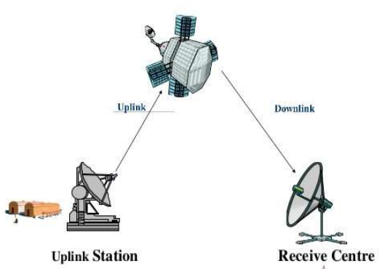
Earth Station Subsystems
Any earth station consists
of four major subsystems
Transmitter
Receiver
Antenna
Tracking Equipment

Slide 5
Earth Station Subsystems
Two other important
subsystems are
Terrestrial interface equipment
Power supply

Slide 6
Earth Station Subsystems
The earth station depends
on the following parameters
Transmitter power
Choice of frequency
Gain of antenna
Antenna efficiency
Antenna pointing accuracy
Noise temperature

Slide 7
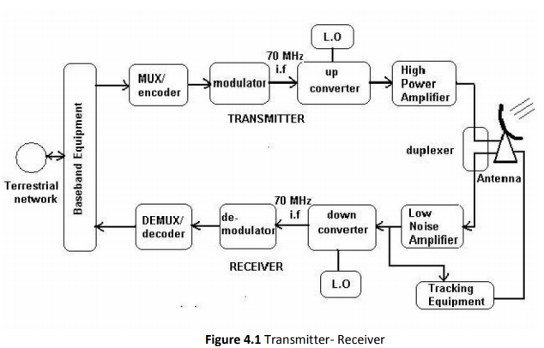
Transmitter and receiver
The functional elements of a basic digital earth station are shown in the below figure

Slide 8
Transmitter and receiver
Digital information in the form of binary digits from terrestrial networks enters earth station and is then processed (filtered, multiplexed, formatted etc.) by the base band equipment.
The encoder performs error correction coding to reduce the error rate, by introducing extra digits into digital stream generated by the base band equipment. The extra digits carry information.
In satellite communication, I.F carrier frequency is chosen at 70MHz for communication using a 36 MHz transponder bandwidth and at 140 MHz for a transponder bandwidth of 54 or 72 MHz.
On the receive side, the earth station antenna receives the low-level modulated R.F carrier in the downlink frequency spectrum.

Slide 9
Transmitter and receiver
The low noise amplifier (LNA) is used to amplify the weak received signals and improve the signal to Noise ratio (SNR). The error rate requirements can be met more easily.
R.F is to be reconverted to I.F at 70 or 140 MHz because it is easier design a demodulation to work at these frequencies than 4 or 12 GHz.
The demodulator estimate which of the possible symbols was transmitted based on observation of the received if carrier.
The decoder performs a function opposite that of the encoder. Because the sequence of symbols recovered by the demodulator may contain errors, the decoder must use the uniqueness of the redundant digits introduced by the encoder to correct the errors and recover information-bearing digits.
The information stream is fed to the base-band equipment for processing for delivery to the terrestrial network.

Slide 10
Antenna Systems :
The antenna system consist of
Feed System
Antenna Reflector
Mount
Antenna tracking System

Slide 11
FEED SYSTEM:
The feed along with the reflector is the radiating/receiving
element of electromagnetic waves.
The reciprocity property of the feed element makes the earth station antenna system suitable for transmission and reception of electromagnetic waves.
The way the waves coming in and going out is called feed configuration.
Earth Station feed systems most commonly used in satellite communication are:
i)Axi-Symmetric Configuration
ii)Asymmetric Configuration

Slide 12
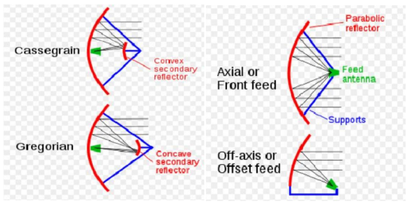
FEED SYSTEM:

Slide 13
FEED SYSTEM: Axi-Symmetric Configuration
In an axi-symmetric configuration the antenna axes are symmetrical with respect to the reflector ,which results in a relatively simple mechanical structure and antenna mount.
Primary Feed :
In primary, feed is located at the focal point of the parabolic reflector.
Many dishes use only a single bounce, with incoming waves reflecting off the dish surface to the focus in front of the dish, where the antenna is located.
when the dish is used to transmit ,the transmitting antenna at the focus beams waves toward the dish, bouncing them off to space. This is the simplest arrangement.

Slide 14
FEED SYSTEM: Axi-Symmetric Configuration
Cassegrain :
Many dishes have the waves make more than one bounce.
This is generally called as folded systems.
The advantage is that the whole dish and feed system is more compact.
There are several folded configurations, but all have at least one secondary reflector also called a sub reflector, located out in front of the dish to redirect the waves.
A common dual reflector antenna called Cassegrain has a convex sub reflector positioned in front of the main dish, closer to the dish than the focus.
This sub reflector bounces back the waves back toward a feed located on the main dish’s centre, sometimes behind a hole at the centre of the main dish.
Sometimes there are even more sub reflectors behind the dish to direct the waves to the fed for convenience or compactness.

Slide 15
FEED SYSTEM: Axi-Symmetric Configuration
Gregorian:
This system has a concave secondary reflector located just beyond the primary focus. This also bounces the waves back toward the dish.

Slide 16
FEED SYSTEM: Asymmetric Configuration
Offset or Off-axis feed:
The performance of an axi-symmetric configuration is affected by the blockage of the aperture by the feed and the sub reflector assembly.
The result is a reduction in the antenna efficiency and an increase in the side lobe levels.
The asymmetric configuration can remove this limitation. This is achieved by offsetting the mounting arrangement of the feed so that it does not obstruct the main beam.
As a result, the efficiency and side lobe level performance are improved.

Slide 17
ANTENNA REFLECTOR:
Mostly parabolic reflectors are used as the main antenna for the earth stations because of the high gain available from the reflector and the ability of focusing a parallel beam into a point at the focus where the feed, i.e., the receiving/radiating element is located.
For large antenna system more than one reflector surfaces may be used in as in the Cassegrain antenna system.

Slide 18
ANTENNA REFLECTOR:
Earth stations are also classified on the basis of services.
Example:
1 .Two way TV ,Telephony and data
2 . Two way TV
3 .TV receive only and two way telephony and data
4 .Two way data
From the classifications it is obvious that the technology of
earth station will vary considerably on the performance and
the service requirements of earth station

Slide 19
ANTENNA REFLECTOR:
For mechanical design of parabolic reflector the following parameters are required to be considered:
✓ Size of the reflector
✓ Focal Length /diameter ratio
✓ RMS error of main and sub reflector
✓ Pointing and tracking accuracies
✓ Speed and acceleration
✓ Type of mount
✓ Coverage Requirement

Slide 20
ANTENNA REFLECTOR:
The size of the reflector depends on transmit and receive gain requirement and beamwidth of the antenna.
Gain is directly proportional to the antenna diameter whereas the beamwidth is inversely proportional to the antenna diameter.
for high inclination angle of the satellite ,the tracking of the earth station becomes necessary when the beamwidth is too narrow.

Slide 21
ANTENNA REFLECTOR:
The gain of the antenna is given by
Gain= (η4ΠA_{eff})/ λ²
Where
A_{eff} is the aperture
λ is wave length
η is efficiency of antenna system
For a parabolic antenna with circular aperture diameter D, the
gain of the antenna is :
Gain= (η4Π/ λ²)( ΠD²/4)
= η (ΠD/ λ )²

Slide 22
ANTENNA REFLECTOR:
The overall efficiency of the antenna is the net product of
various factors such as
1. Cross Polarization
2. Spill over
3. Diffraction
4. Blockage
5. Surface accuracy
6. Phase error
7. Illumination
In the design of feed ,the ratio of focal length F to the diameter
of the reflector D of the antenna system control the maximum
angle subtended by the reflector surface on the focal point.
Larger the F/D ratio larger is the aperture illumination
efficiency and lower the cross polarization.

Slide 23
ANTENNA MOUNT :
Type of antenna mount is determined mainly by the coverage requirement and tracking requirements of the antenna systems.
Different types of mounts used for earth station antenna are:
i) The Azimuth –elevation mount :
This mount consists of a primary vertical axis.
Rotation around this vertical axis controls the azimuth angle.
The horizontal axis is mounted over the primary axis, providing the elevation angle control.
ii) The X-Y mount.
It consists of a horizontal primary axis (X-axis) and a secondary axis (Y-axis) and at right angles to it. Movement around these axes provides necessary steering.

Slide 24
Earth Station Tracking System:
Tracking is essential when the satellite drift, as seen by an earth station antenna is a significant fraction of an earth station’s antenna beam width.
An earth station’s tracking system is required to perform some of the functions such as
i)Satellite acquisition
ii)Automatic tracking
iii)Manual tracking
iv)Program tracking.

Slide 25
Earth Station Tracking System:
i)Satellite Acquisition:
Before communication can be established it is necessary to acquire a satellite.
One method is to program the antenna to perform a scan around the predicted position of the satellite.
The automatic tacking is switched on when the receiver signal strength is sufficient to lock the tracking receiver to the beacon.
ii)Automatic Tracking:
After acquisition a satellite needs to be tracked continuously.
This function is performed by the automatic tracking system.
Auto-track systems are closed-loop control systems and are therefore highly accurate.
This tracking mode is the preferred configuration when accuracy is the dominant criterion.

Slide 26
Earth Station Tracking System:
iii)Manual track:
To avoid a total loss of communication due to a failure in the tracking system, earth stations generally also have manual mode.
In this mode an antenna is moved through manual commands.
iv)Program Track:
In this tracking mode the antenna is driven to the predicted satellite position by a computer.
The satellite position predictions are usually supplied by the satellite operators.
It may be noted that since a program track system is an open-loop control system, its accuracy is mainly governed by the accuracy of the prediction data.

Slide 27
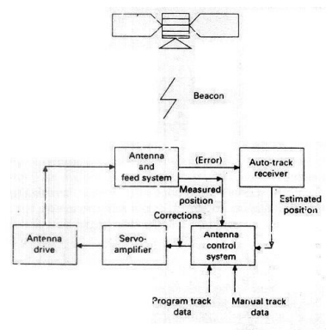
Earth Station Tracking System:
MAIN ELEMENTS OF A SATELLITE TRACKING SYSTEM

Slide 28
Earth Station Tracking System:
MAIN ELEMENTS OF A SATELLITE TRACKING SYSTEM
Communication satellites transmit a beacon which is used by earth stations for tracking.
The received beacon signal is fed into the auto-track receiver where tracking corrections or, in some auto-track systems estimated positions of the satellite are derived.
In other auto-track techniques the feed system provides the required components of error signals.
The outputs of the auto-track receivers are processed and used to drive each axis of the antenna to the estimated satellite position.

Slide 29
Earth Station Tracking System:
MAIN ELEMENTS OF A SATELLITE TRACKING SYSTEM
In the manual mode, an operator sets the desired angles for each axis on a control console.
This position is compared with the actual antenna position, obtained through shaft encoders, and the difference signal is used to drive the antenna.
In the program track mode the desired antenna position is obtained from a computer.
The difference in the desired antenna positions constitutes the error and is used to drive the antenna.

Slide 30
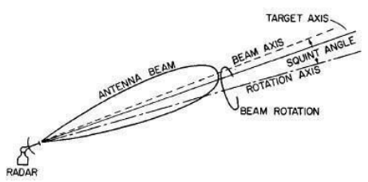
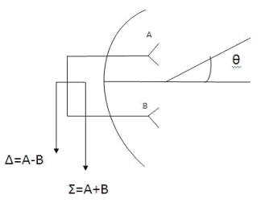
Earth Station Tracking System:
Auto Track system:
There are three main types of auto-track system which have
been commonly used for satellite tracking;
i) conical scan
ii)monopulse
iii)step-track
conical scan
monopulse

Slide 31
Terrestrial Interface :
Earth station is a vital element in any satellite communication network.
The function of an earth station is to receive information from or transmit information to, the satellite network in the most cost-effective and reliable manner while retaining the desired signal quality.

Slide 32
Terrestrial Interface :
The design of earth station configuration depends upon many factors and its location.
But it is fundamentally governed by its location which are listed below,
In land
On a ship at sea
Onboard aircraft
The factors are
Type of services
Frequency bands used
Function of the transmitter
Function of the receiver
Antenna characteristics

Slide 33
Terrestrial Interface :
The terrestrial interface comprises a wide variety of equipment.
At one extreme, when the terminal is a mobile or receive only station, there may be no terrestrial interface equipment at all.
The operating devices, such as TV receivers, telephones, data sets, and so on, are used right at the earth station.
At the other extreme, we find the interface equipment necessary in a large commercial satellite system for fixed service.
In such cases, hundreds of telephone channels, together with data and video, are brought to the station by microwave and cable systems using either frequency or time division terrestrial multiplex methods.

Slide 34
Terrestrial Interface :
The signals must be changed from those formats into formats suitable for satellite transmission.
In an easy case, frequency division multiplex groups and super groups, as brought in from terrestrial transmission facilities, can be transmitted directly or with simple translation in baseband frequency from the satellite after modulation and up conversion, but in many cases it is necessary to reformat extensively for terrestrial circuits.
Individual telephone channels, for instance, may all be transmitted on the same carrier, which is received by many earth stations in the network.
The return channels for particular conversation circuits will be coming in on various carrier frequencies, depending on their source, and they must be tagged and put together with the corresponding outgoing circuit to make up a terrestrial circuit.
This can be a complex process. The presence of video and data complicates matters further.

Slide 35
Terrestrial Interface :
If the satellite transmission is single channel per carrier, it is necessary to bring each terrestrial carrier down to baseband before remodulation.
The interfaces between terrestrial time division and satellite frequency division systems, and vice versa, are complicated and can be accomplished in a variety of ways.
Television video signals must often be separated from order wire channels, program sound channels, cueing channels, and so on, and then matched up again at the proper point.
Usually, in the systems engineering and programming planning phase it is only necessary to be alert to the problems and possibilities, the detailed design can be saved until later in the program.

Slide 36
PRIMARY POWER:
Primary power systems vary from plain battery or solar cell operated remote transmitters for data gathering to huge, combined commercial power and diesel generator systems for large stations.
Most transmit and receive earth stations require some kind of "no break” power system, that is emergency power to continue the communications during commercial power outages.
Such power outages are frequent, even in highly organized industrial areas, if for no reason other than thunderstorms.

Slide 37
PRIMARY POWER:
The ‘no break’ transition derives its name from the necessity to make the change over from one power system to another without any interruption in service.
Almost all systems today use batteries to effect this transition.
Some systems have been devised in which motor generators store enough energy in flywheels to permit a smooth mechanical transition.

Slide 38
TEST METHODS:
Earth stations are typically provided with complex test equipment, ranging from that necessary for routine measurements of voltage, power, temperature, and soon, to sophisticated and specialized measurements unique to satellite communication.
One of these is noise power ratio (NPR), the traditional measure of intermodulation noise for FDM systems in the communications field.
The principle of NPR measurement involves loading the entire baseband spectrum, save for the one voice -frequency channel slot, with noise, simulating in total the loading of the system by actual voice traffic in all but that channel Noise appearing in the unloaded slot is a manifestation of intermodulation.
The ratio of that noise power to the per -channel loading noise power is the NPR.

Slide 39
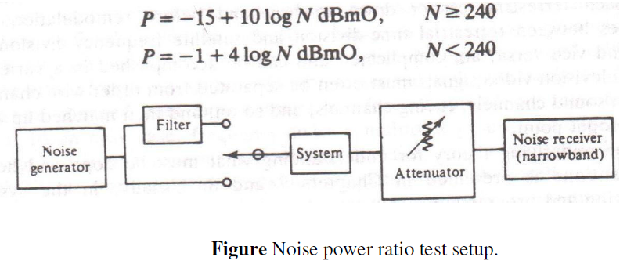
TEST METHODS:
NPR is measured by a setup as shown in Figure.
The system can be between any two points of interest.
The noise generator is band limited by filters to the baseband, and the noise generator level is set to simulate full load according to the CCIR formulas

